Slide 1


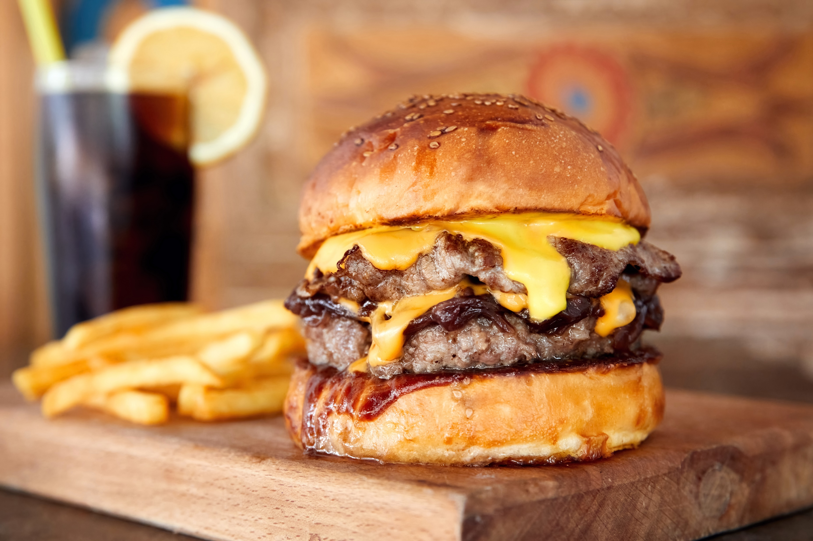


Right click, select “Replace Picture” to place your burger photo.
Delete this text before exporting (go to “File/Export”)
your framed burger image.
Insert title or text here.

